Slide 1
Mobile Device Threat Review
Student’s Name
Institutional Affiliation

Slide 2
Data theft threat
Data theft threat occurs when an intruder steals information saved on mobile devices.
The unknown victim aims at compromising privacy of the owner.
Some thieves obtain confidential data with an intention of committing frauds.
For example, when someone gives out password to get technical help from another person, data can be stolen through sharing of the secret PINS (Warren, 2015).
People should avoid exposing their passwords and ensure their portable storage devices are safe.
Notes:
The threats of data theft are increasing due to advancement of technology.
Data theft can occur inside or outside business premises.
Employees with ill motive can steal organization’s data.

Slide 3
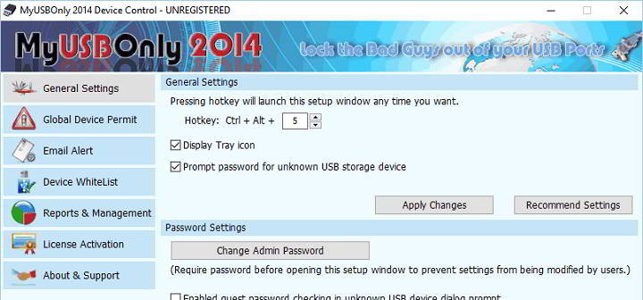
Device control threat
Device control is the act of preventing unauthorized access to data in portable devices.
Data saved in movable devices is more exposed to the risk of being compromised than that in non-movable gadgets.
For example, malicious people working within a firm use USB gadgets to interfere with systems and to obtain data fast.
Removable media is the most vulnerable resource in organizations (Beam et al., 2017).
Companies should reduce the amount of data stored in portable devices.
Notes:
Device control helps in managing and protecting organization’s data.
Companies can use encryption to reduce threats of interference.

Slide 4
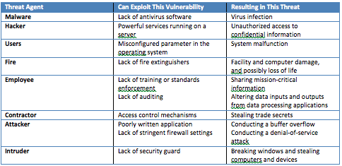
System access threats
Portable devices expose organizations to threats of unauthorized access to sensitive resources.
Information related to financial position of a firm is one of the most crucial resource.
When malicious individuals obtain data, a firm loses its information confidentiality.
Reliability of information is affected and saved data can no longer be trusted when systems are hacked (Lian et al., 2016).
For example, business operations that are based on computer systems can be disrupted when systems are corrupted by people with passwords.
.
Notes:
Supervisors should closely monitor employees to reduce instances of system interference.
Information technology experts should continue researching emerging trends in system access threats.
Firms should conduct continuous evaluations on movable devices.

Slide 5
References
Lian, J. J., Paterra, A., & Woolward, M. (2016). U.S. Patent Application No. 15/008,298.
Beam, L. M., Nesteroff, L., Shimuk, N. L., Sood, A., Chavez, R., Towstopiat, O. M.,…& Sharma, S. (2017). U.S. Patent Application No. 14/983,983
Warren, M. (2015). Modern IP theft and the insider threat. Computer Fraud & Security, 2015(6), 5-10

